Slide 1








Predictive Air Quality System
Real-Time Monitoring + AI Forecasting

Slide 2
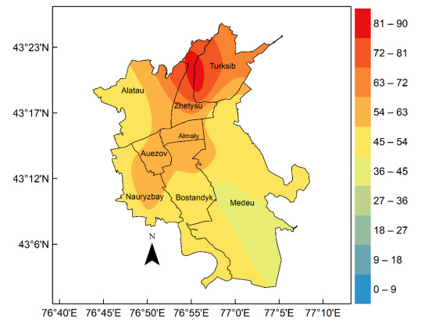
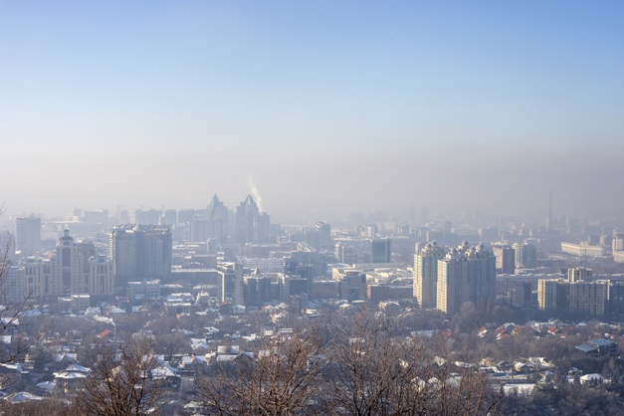

Problem Statement
Air Quality Challenges in Almaty
Almaty suffers from extremely poor winter air quality.
PM2.5 levels exceed WHO limits by 10–15x
Thermal inversions trap pollution inside the city
Diseases increase: asthma, bronchitis, COPD, heart issues
No system predicts pollution before it becomes dangerous
Citizens, schools, hospitals have zero time to prepare

Slide 3
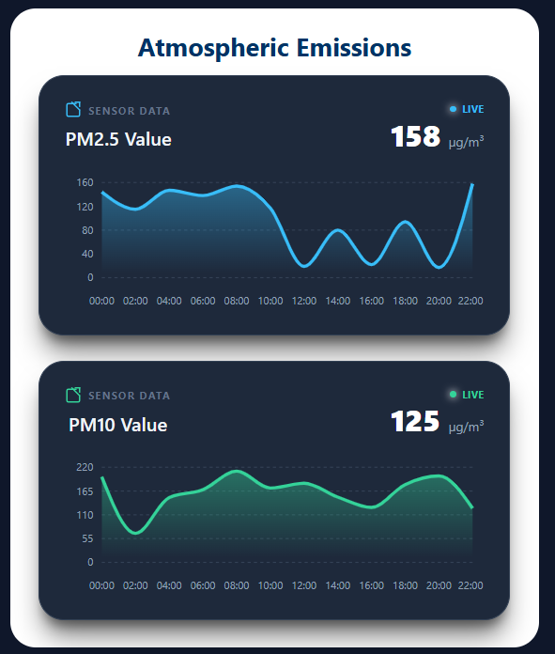
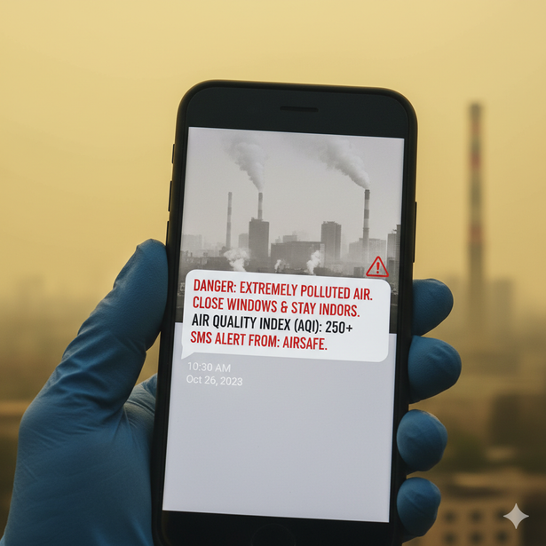
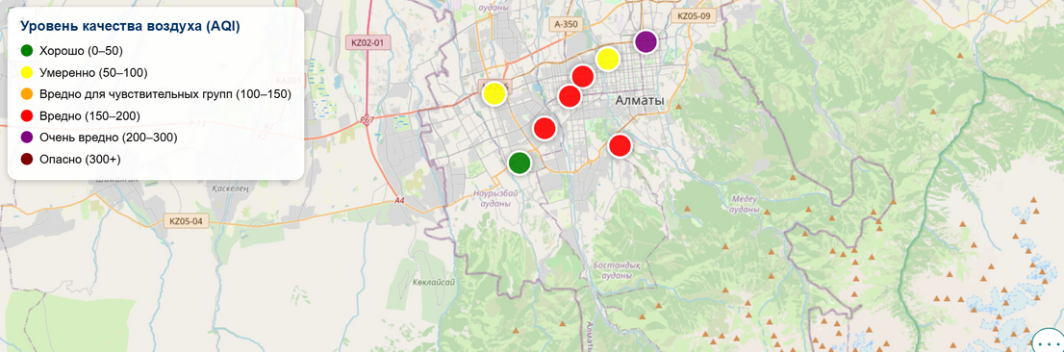
Our Solution
Predictive Air Quality System for Almaty
• Hyperlocal PM2.5/PM10 predictions (1–12 hours ahead)
• Live map: pollution hotspots in Almaty
• SMS alerts before dangerous spikes
• Automated social media reporting
• Seasonal health reports for hospitals/schools
• Data dashboard for city officials

Slide 4
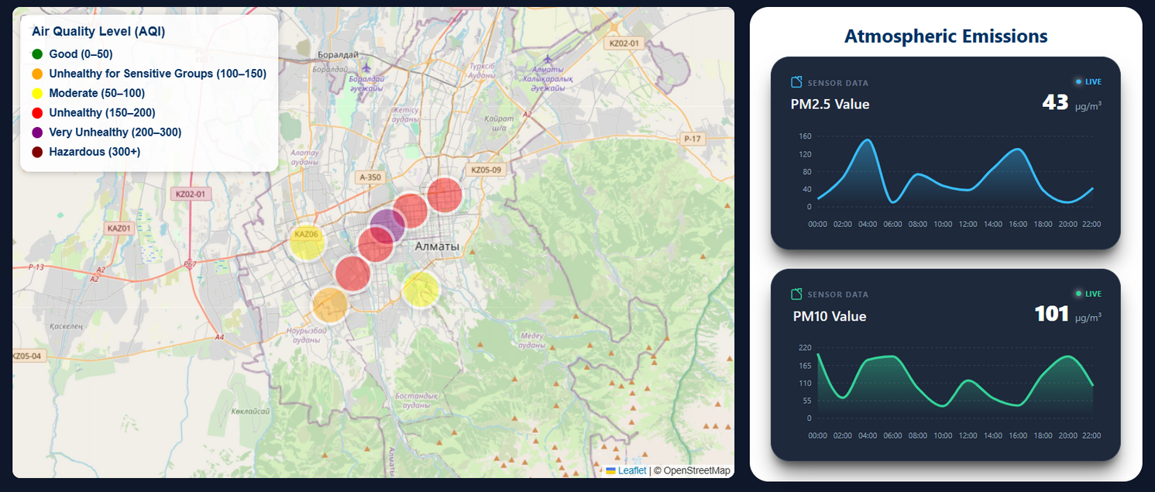
HOW IT WORKS?
COLLECT DATA: CITY SENSORS + WEATHER + TRAFFIC + SATELLITE.
PROCESS & FUSE: CLEAN AND COMBINE ALL DATA.
AI FORECAST: PREDICT PM2.5/PM10 24–48H AHEAD.
ALERTS & DASHBOARD: SMS ALERTS, GOVERNMENT DASHBOARDS, SEASONAL REPORTS.
CONTINUOUS LEARNING: MODEL UPDATES DAILY FOR ACCURACY.

Slide 5

Primary Target: Government (B2G)
• Smart-City decision dashboards
• Pollution alert infrastructure
• Urban planning + environmental policy
• Health sector early-warning systems
• Emergency response coordination

Slide 6



Project Evaluation
Novelty: Predictive forecasting; no similar local solution
Demand: Almaty government needs data-driven tools for health & urban planning
Health & economic impact: Pollution costs ~$10.5B annually (World Bank)
Business Model: B2G; governments pay for ,dashboards, reports, predictive alerts
Team: AI + IoT + software expertise; can collaborate with universities or tech partners
Future work (B2B): real estate, schools, hospitals

Slide 7

Competitive Advantage
Why Governments Will Choose Us
Predictive Forecasting (1–24) — competitors mostly reactive.
Hyperlocal Accuracy — tailored for Almaty’s geography.
Multi-Channel Alerts — SMS, public displays, dashboards.
Visuals: Table comparing features vs other platforms

Slide 8

Conclusion
Protects citizens from harmful air pollution in Almaty
Empowers government with data-driven urban planning
First AI-driven predictive AQI system in the region
B2G model ensures sustainability and scalability
Pilot-ready, technically feasible, aligned with Smart City goals

Slide 9


Samiullah Laly
TEAM
MEMBERS
Khairullah Chakir

Slide 10
THANK YOU
Q&A

